Slide 1
Scaling Data Science Teams & Tech Shaun “Kafka” McGirr – Lead Data Scientist David “Blockchain” Asboth – Data Scientist 24 May 2018

Slide 2
Overview
Scaling teams
Context matters
What is data science (for us)
How we work given the above
Scaling tech
What our workflows imply about tools
Our approach until recently
Our approach now and in the future

Slide 3
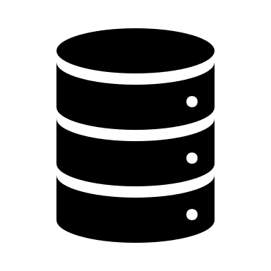
Why Data Solutions exists
Cox Automotive UK runs wholesale vehicle auctions, consumer-facing retail websites, logistics and finance for moving and funding vehicles…and more!
We create value by joining up (diverse) data assets
This requires a diverse data team of ~35 people (DE, BI, DS, Product, Web)

Slide 4
What does Data Science work on?
Batch data product and companion tool to provide live and historical market intelligence on any vehicle in UK (100s of millions of possible questions)
Internal consulting to help other parts of the business solve gnarly business problems using data science (especially prediction)
Natural Language Processing to automate data cleaning
Wide variety of problems but only three unicorns people…uhoh

Slide 5
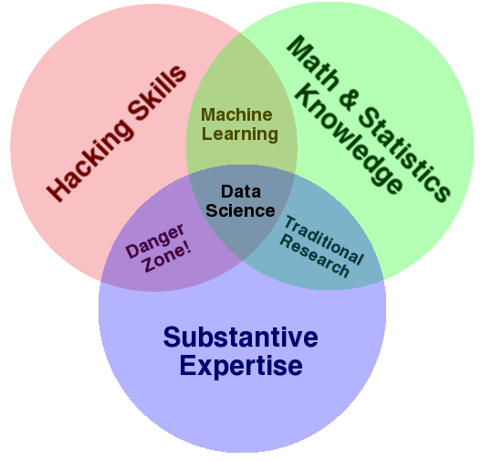
What is Data Science at Cox Automotive?
Variations on a theme by Drew Conway
Thinking like a developer “just enough” to automate menial steps, increasing time for creativity (Not becoming light-weight developers)
Thinking like a statistician “just enough” to assess uncertainty, making our data safer for decisions
(Not becoming afraid of drawing conclusions)
Important: software tools merely support these principles
Thinking like a customer
(Not just as data person)
Thinking like a scientist
(Not just a technician)

Slide 6
Mapping competencies on to a workflow
Scientist
Juggling four “hats”
Statistician
Developer
“I wonder…”
Proof of concept
Working prototype
Software
R
R&D
D
Customer
Which hats?
ANALYST
“HALF-STACK DATA SCIENTIST”
TESTER
Notes:
Interestingly, we have a PoC before we have a prototype.

Slide 7
Got the right hats to scale, what now?
Lots of options
R packages (Hadley Wickham) Final report section headings (CRISP-DM)

Slide 8
Radical idea: everything of value in data is preceded by a valuable question
Better questions generate better answers
Nebulous business
What are the right things to work on?
Big question
How can we get to proof-of-concept?
Lots of little questions
Notes:
This is a funnel: more things enter at the top than exit the bottom.
How can we spend a small amount of work to quickly prove the value of further work?
Once we show that initial value, how do we “scale up” towards a proof-of-concept?
If our proof-of-concept is successful, how do we ”scale up” again to a working prototype?
How do we take viable working prototypes to production scale?

Slide 9
Scaling Data Science Technologies
Notes:
Introductions

Slide 10
Case Study: Vehicle Market Data Feed
What does the market look like for my car?
Rough workflow:

Slide 11
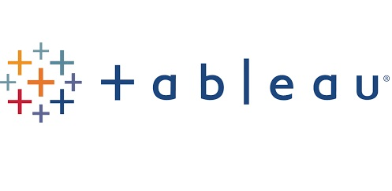
Data Science Workflow – Phase 1: Exploration
Small to medium data, in memory for speed
The Ford Focus problem
One question at a time, because we don’t know what the questions should be
What do we mean by “the market”? What is a “car”?
Specialist tools focused on rapid exploration and visualisation

Slide 12
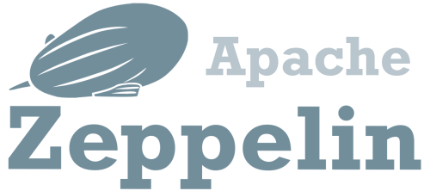
Data Science Workflow – Phase 2: Scaling Up Analysis
Big data, too much to fit in memory
Questions are fixed, want to scale up to more data
Does our approach work for Porsche?
Is our approach scalable (easy to be performant on a small sample)?
Specialist tools focused on scalability

Slide 13
Data Science Workflow – Phase 3: Production?
All the data
Repeating the same questions
Robustness and scalability are the focus
Tools?
TOO SLOW
TOO HARD

Slide 14
Who is responsible for production?

Slide 15
Who is responsible for production?
Data Scientists / BI own the business logic
Do not want to, and should not be, responsible for robustness
Data Engineers / Developers own the production platform
Do not want to, and should not be, responsible for business logic
This is the same problem
Can we find a one-size-fits-all solution?

Slide 16
Should Data Scientists just
learn more tools?

Slide 17
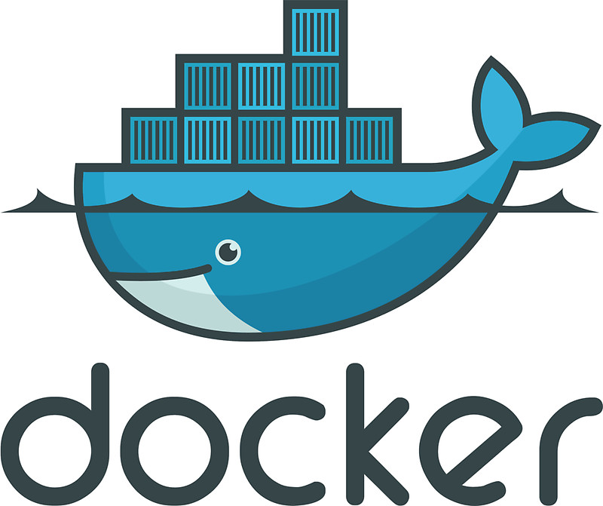
“Full-Stacking” your Half-Stack Data Scientists

Slide 18
Should we entirely decouple R&D and production?

Slide 19
R&D and Production – complete separation?
Traditional model:
Notes:
Bad because:
Duplicating work = more time spent in development
Neither side knows anything about the other
Who’s responsible when something goes wrong?

Slide 20
Should we buy off-the-shelf?

Slide 21
Data Science Platforms: The Sales Pitch
Exploratory data analysis
Statistical modelling
Drag and drop
“One click deployment”
Can answer individual small questions
But how do you combine those to answer multiple questions simultaneously?

Slide 22
Solution:
Compromise

Slide 23
Our Requirements
Our Solution
Let Data Science and BI specify SQL
Let Spark orchestrate SQL queries for performance
Allow intermediate datasets and exploration when “scaling up”
SQL for business logic
Hadoop / Spark for platform
Faster to “scale up” analysis than native SQL on cluster (Hive/Impala)

Slide 24
Bridging the Gap with Compromise
Undefined implementation
Data Science
Slow & unrepeatable
Fast & repeatable
Data Engineering
Fixed implementation

Slide 25
Bridging the Gap with Compromise
Undefined implementation
Data Science
Slow & unrepeatable
Fast & repeatable
Data Engineering
Fixed implementation
Notes:
Data Science give up “free form experimentation”
and gain performance and scalability
Data Engineering give up “fast, repeatable, stable implementation”
but just enough to gain freedom from supporting huge, confusing SQL queries

Slide 26
Introducing Waimak
Add SQL queries to a simple Scala/Spark wrapper
Branching!
Notes:
Data processes can branch out, flow separately, and meet “down river”

Slide 27
Introducing Waimak
Logical progression of data ingestion & manipulation
SQL queries are backwards, right?
Waimak encourages a more natural ordering
Notes:
SQL queries are backwards
You select columns before you know what the data sources are
If you need business logic to create intermediate datasets, these become impenetrable
Waimak encourages a logical ordering
Load your dataset
Filter out rows you don’t need
Create any intermediate datasets you need
Finally tell it what columns to select
“True ETL”

Slide 28
Introducing Waimak
A toolset & new way of thinking – not a product!
Custom code is still required for each project

Slide 29
Other Benefits
The right people own the right things
Data Science keep ability to experiment
Data Engineering keep ability to run at scale
Production is owned by everyone

Slide 30
Benefits to Business
Increased “bus factor”
Minimal reimplementation = time and money saved
Quicker R & D
More products
More responsive to feedback
More value

Slide 31
Coming to a GitHub repo near you…
Notes:
Email us to ask about Waimak!

Slide 32
Q&A
shaun.mcgirr@coxauto.co.uk / @shaunmcgirr
david.asboth@coxauto.co.uk / @davidasboth
coxautodata.com

